Slide 1

BDM Project
Parul Ghai
Prateek Gupta
Priyal Katudia
Shubham Bhargava

Slide 2

Introduction- Bike Store Management System
We have created a database system on Bike Store.
The Bike Store SQL project involves designing and implementing a relational database to manage data for a fictional bike store.
This project aims to provide a comprehensive solution for tracking customer interactions, sales transactions, inventory management, and employee activities within the bike store.

Slide 3

Dataset
The dataset comprises nine interconnected tables: customers, orders, order_items, staffs, stores, categories, products, stocks, and brands.

Slide 4
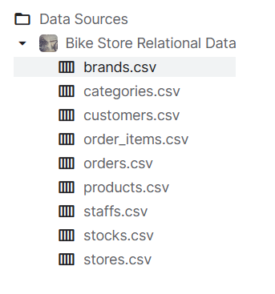
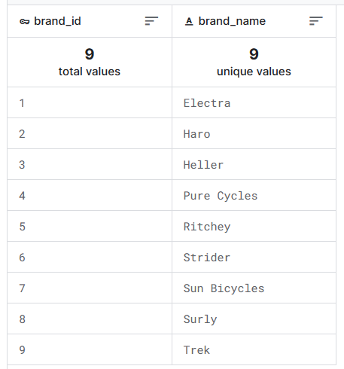
Dataset - Bike Store Exploratory
Our data tables comprises of following sets:
The brands table stores the brand’s information of bikes:

Slide 5
DATA CLEANING

Slide 6
Data Cleaning
Modify column:
ALTER TABLE your_table
ALTER COLUMN column_name new_data_type;
Renamed al the columns using query:
ALTER TABLE your_table
RENAME COLUMN old_name TO new_name;
Remove duplicate data:
SELECT DISTINCT * FROM your_table;

Slide 7
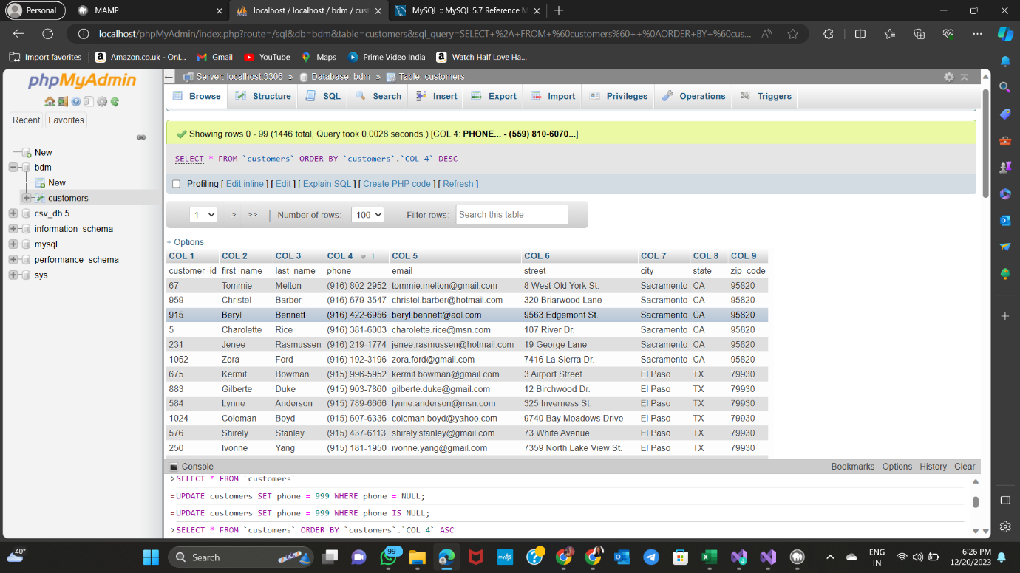
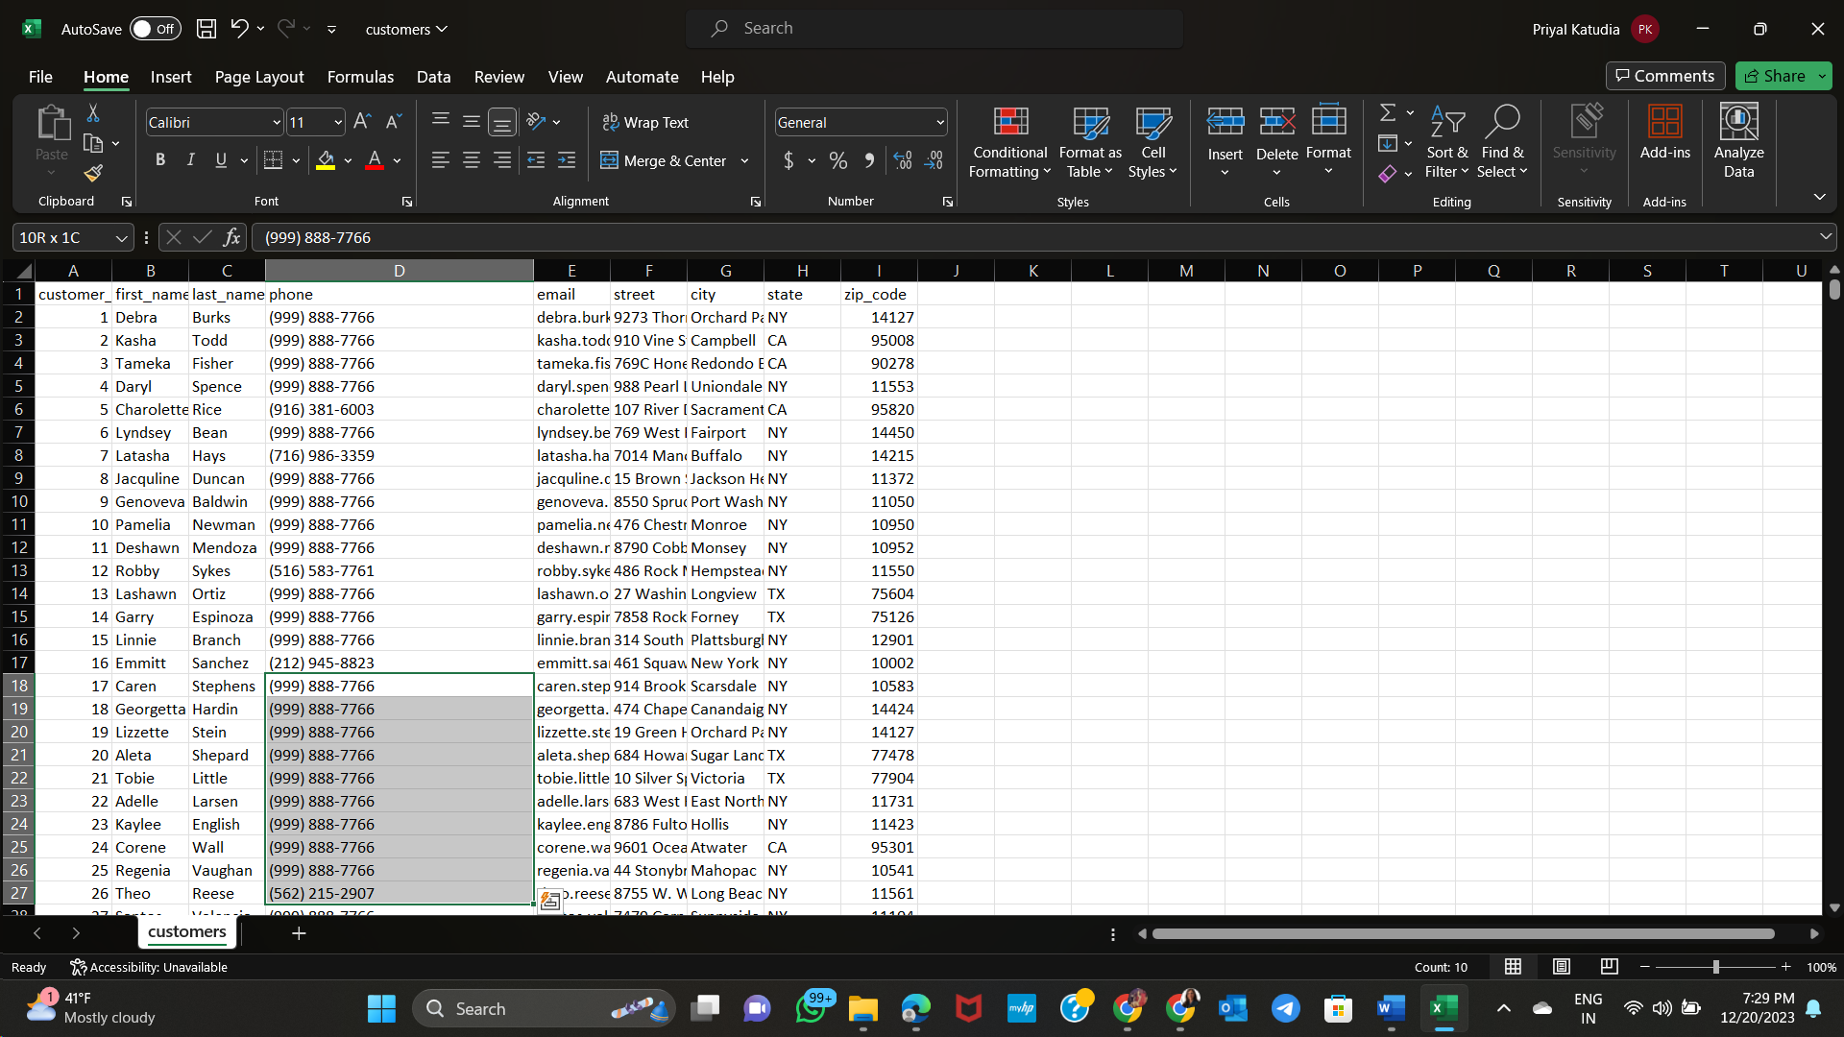
Data Cleaning -
Replace missing values:
SELECT * FROM `customers` WHERE 1
UPDATE customers
SET phone = (999) 888-7766
WHERE phone IS NULL;
7

Slide 8
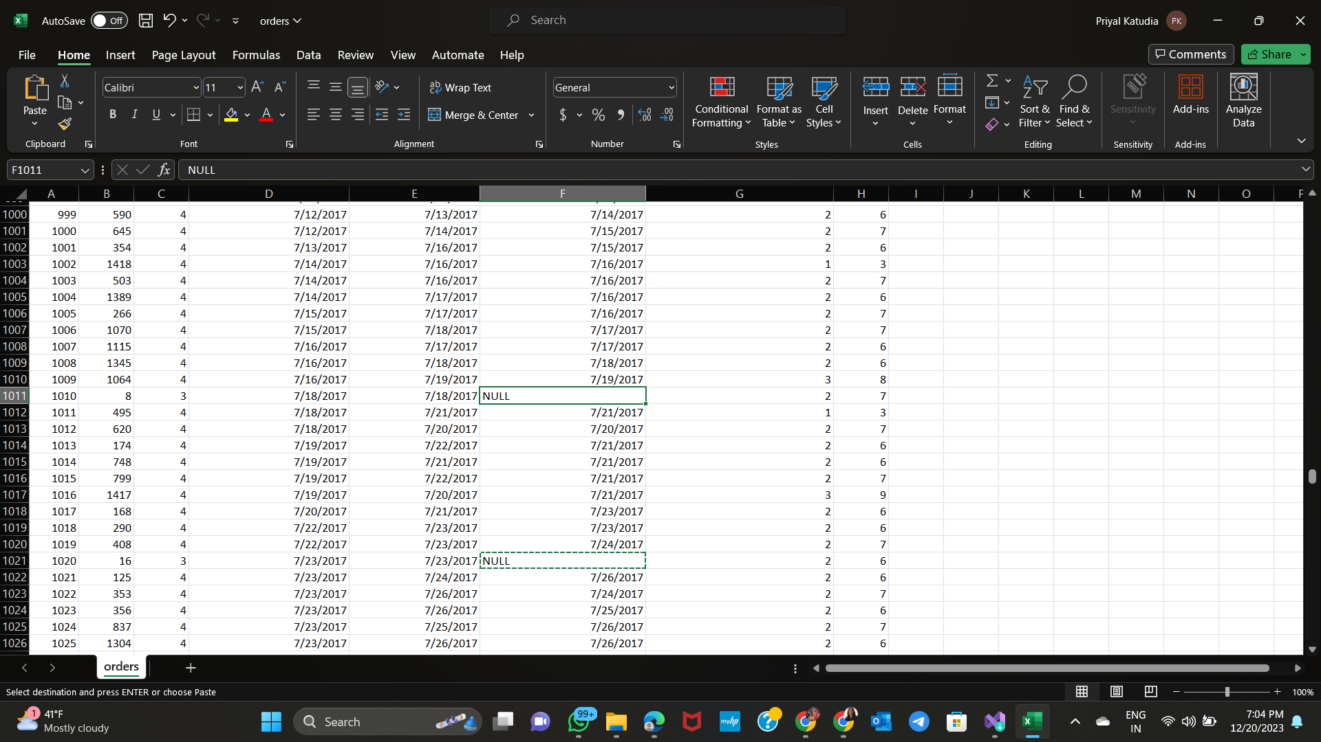
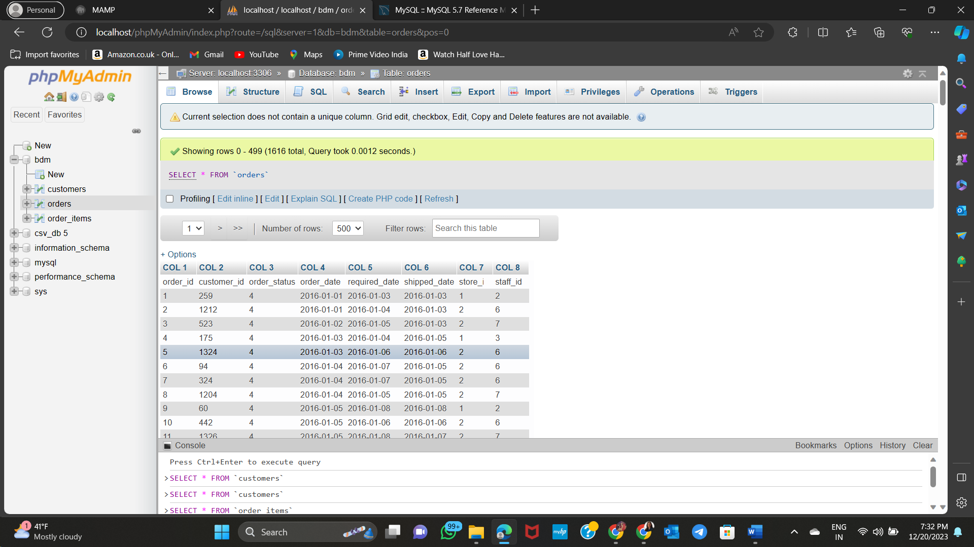
Data Cleaning -
Delete rows with missing values:
DELETE FROM orders
WHERE shipped_date IS NULL;
8

Slide 9
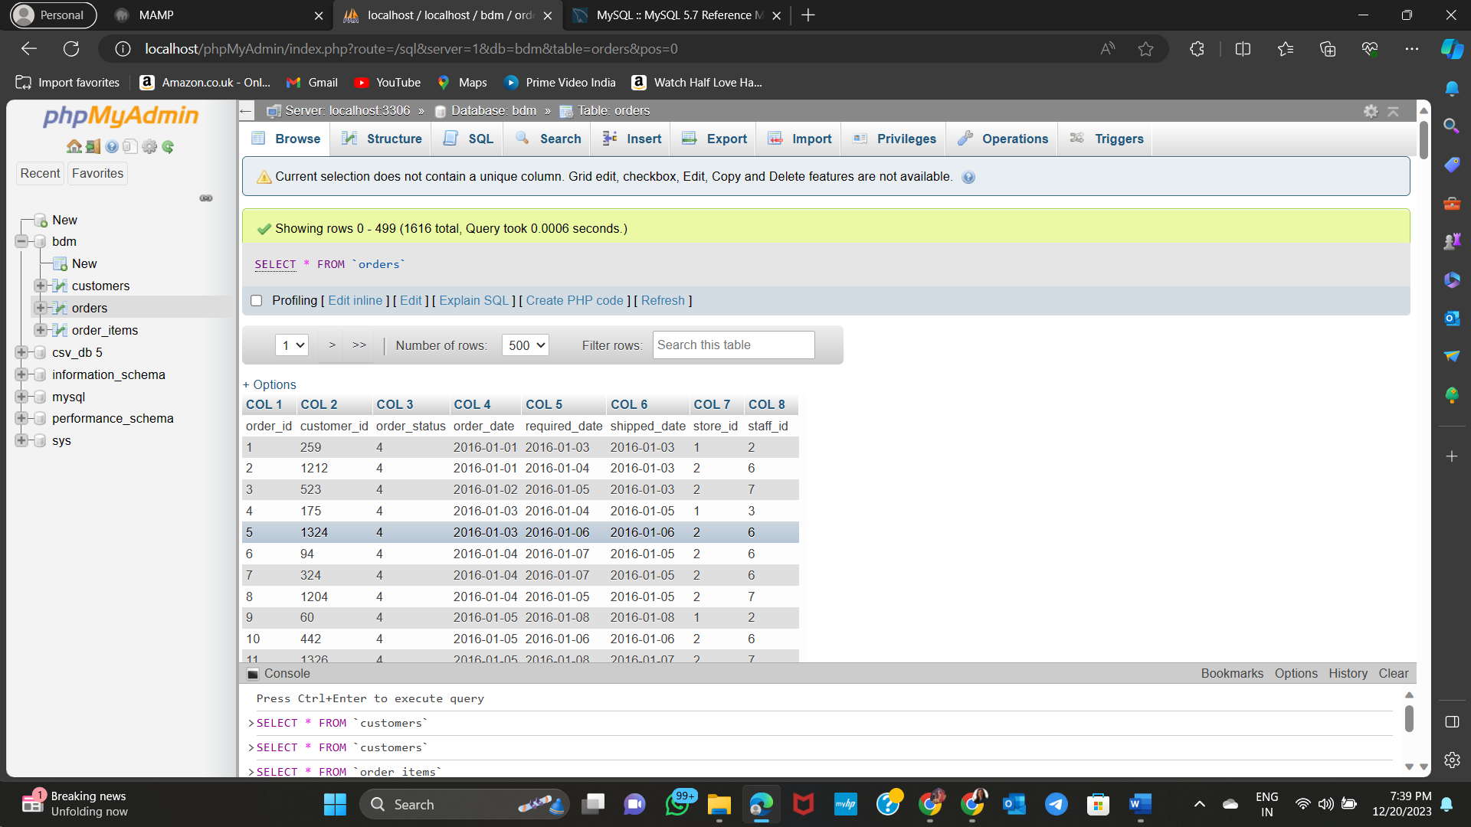
Data Cleaning -
& Deal with outliers:
Identify outliers:
SELECT * FROM your_table
WHERE column_name > upper_bound OR column_name < lower_bound;
9

Slide 10
CREATE SQL CODE AND IMPORT DATASET

Slide 11
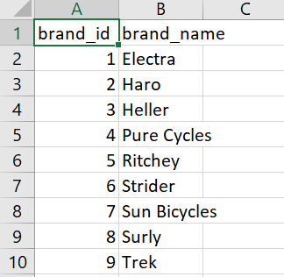
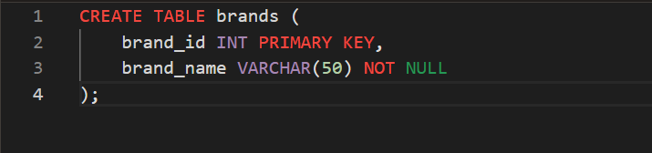
Brands
Table has brand_id as primary key and columns giving information about different brands.

Slide 12
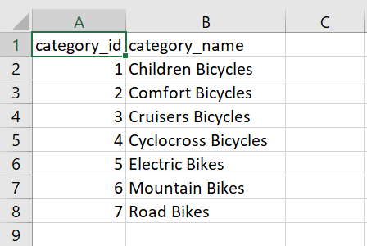
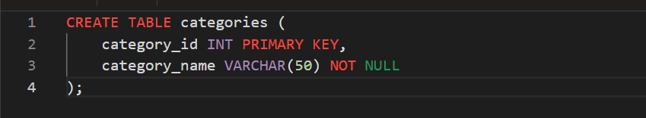
Categories
Table has category_id as primary key and columns giving information about different categories.

Slide 13
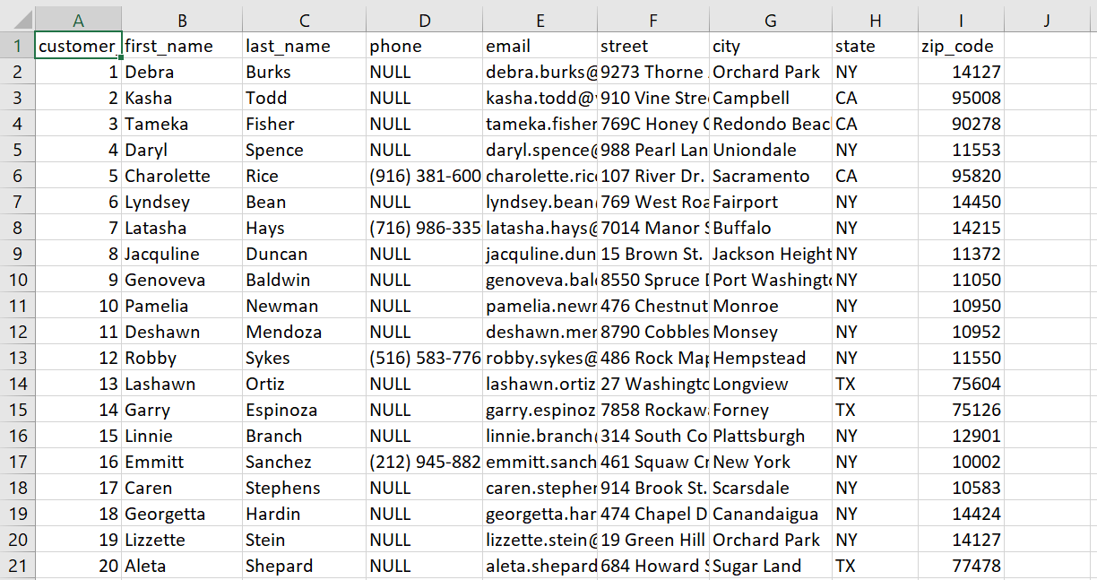
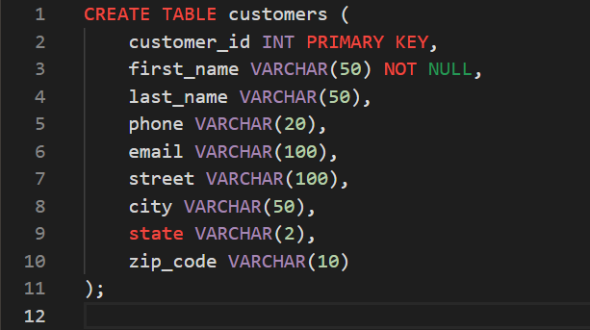
Customers
Table has customer_id as primary key and columns giving information about contact and address of customers.

Slide 14
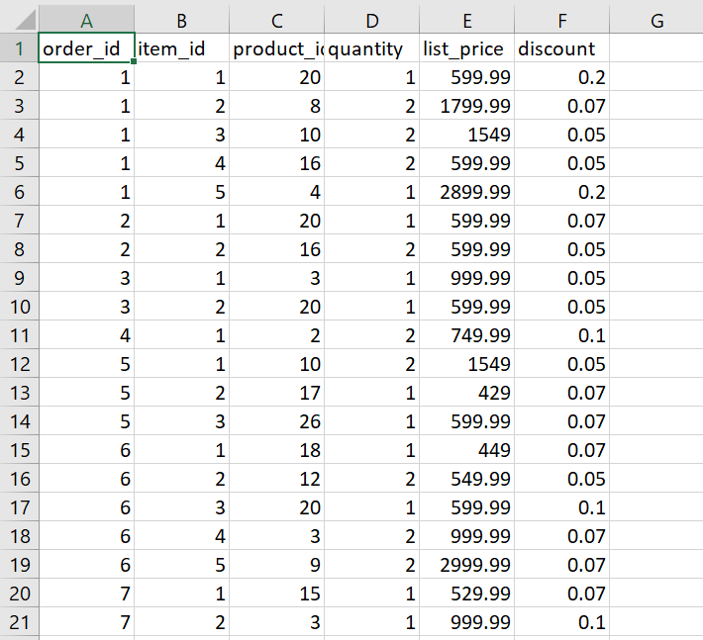
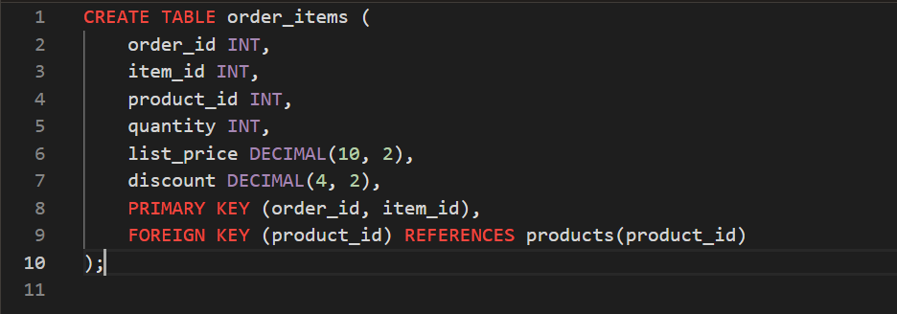
Order_items
Table has primary key( order_id, item_id) and columns giving information about product and prices.

Slide 15
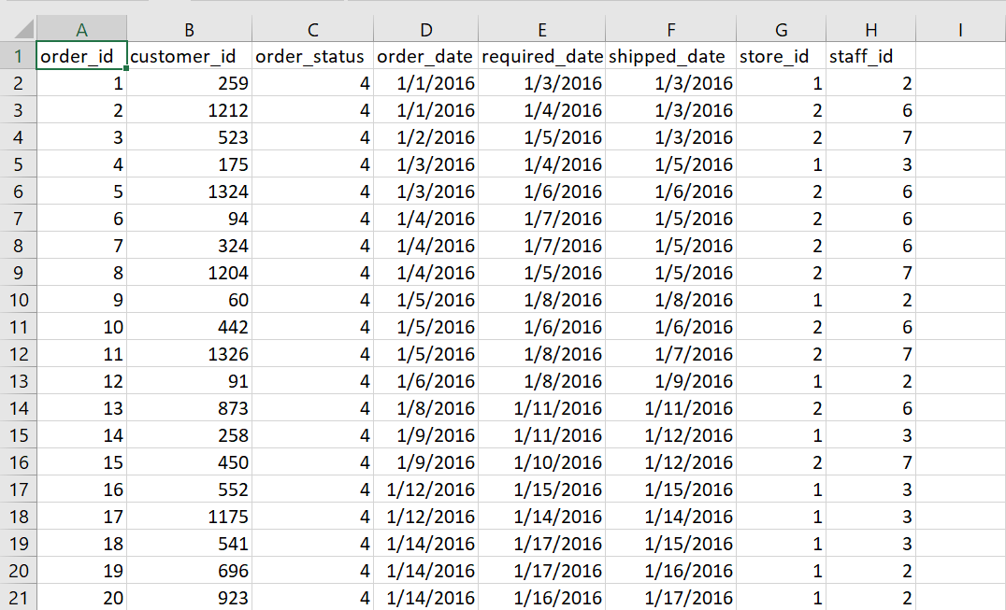
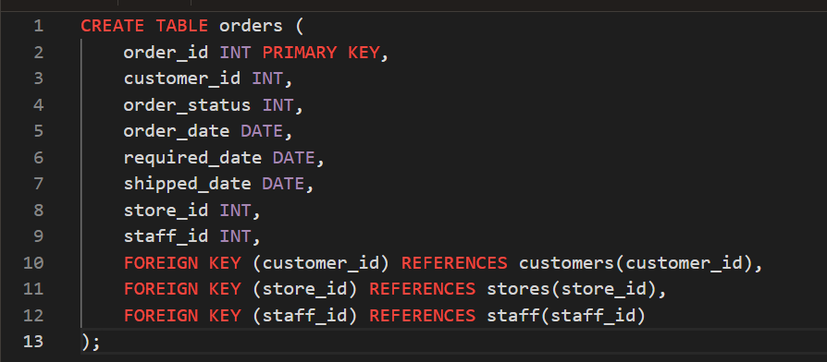
Orders
Table has order_id as primary key and columns giving information about Orders.

Slide 16
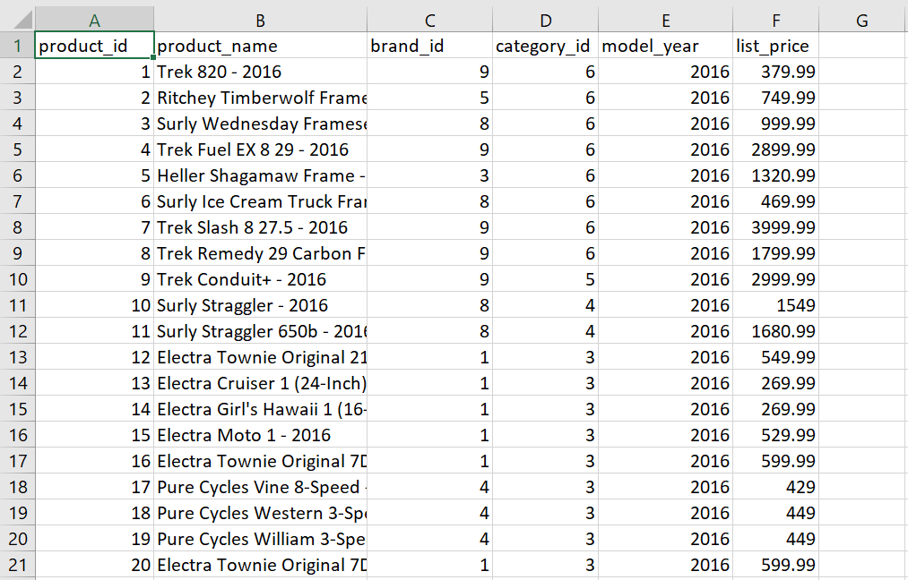
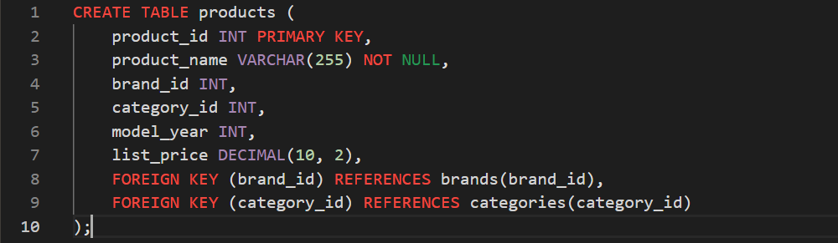
Products
Table has product_id as primary key and columns giving information about products.

Slide 17
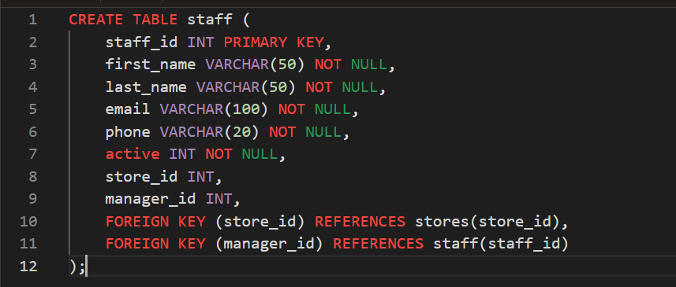
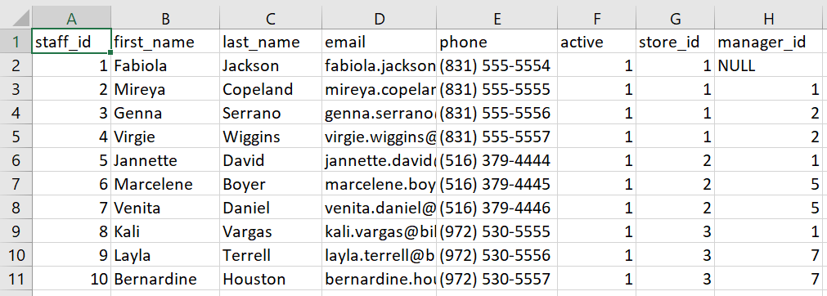
Staffs
Table has staff_id as primary key and columns giving information about staff members.

Slide 18
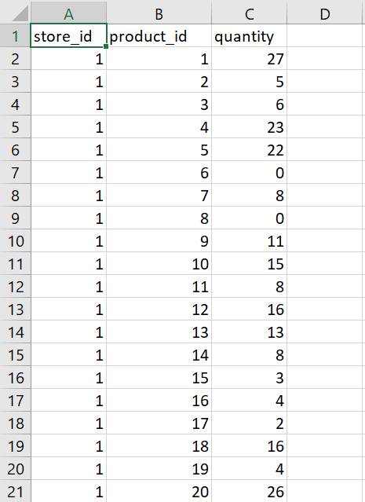
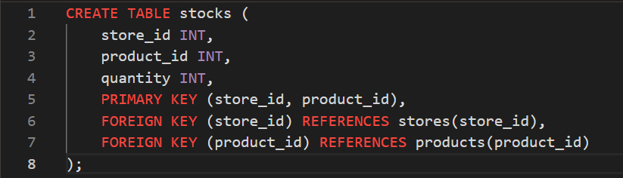
Stocks
Table has primary key( store_id, product_id) and columns giving information about stocks of products.

Slide 19
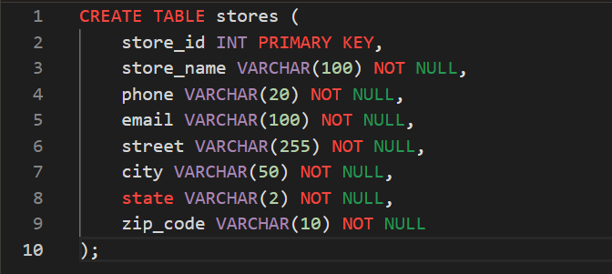
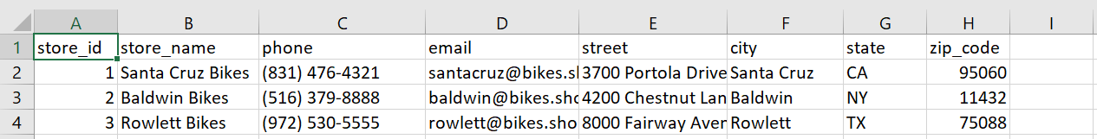
Stores
Table has store_id as primary key and columns giving information about different stores.

Slide 20
NORMALIZATION

Slide 21
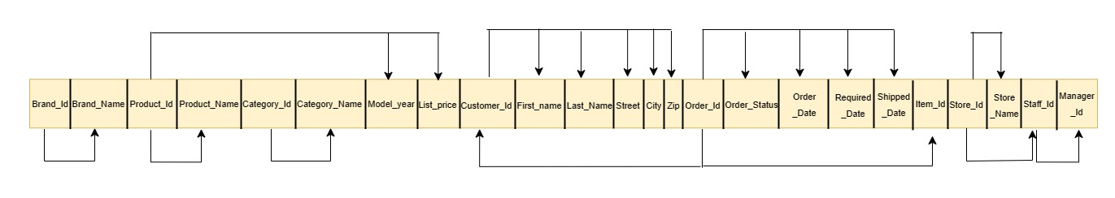
Normalization
Raw Data before Normalization

Slide 22
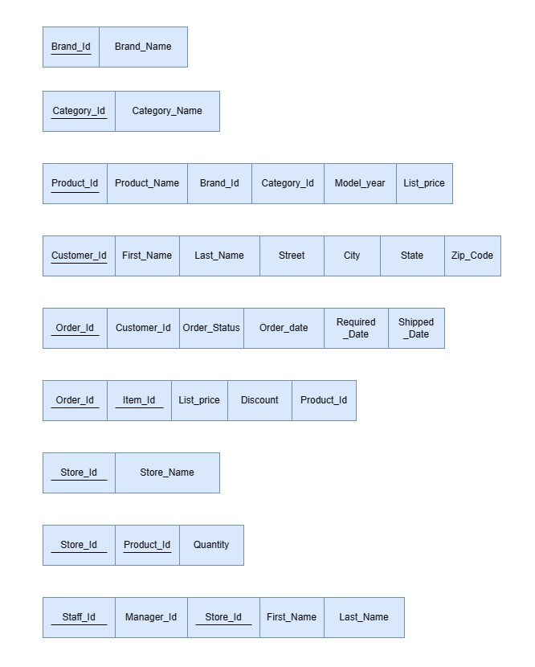
Normalized data structures

Slide 23
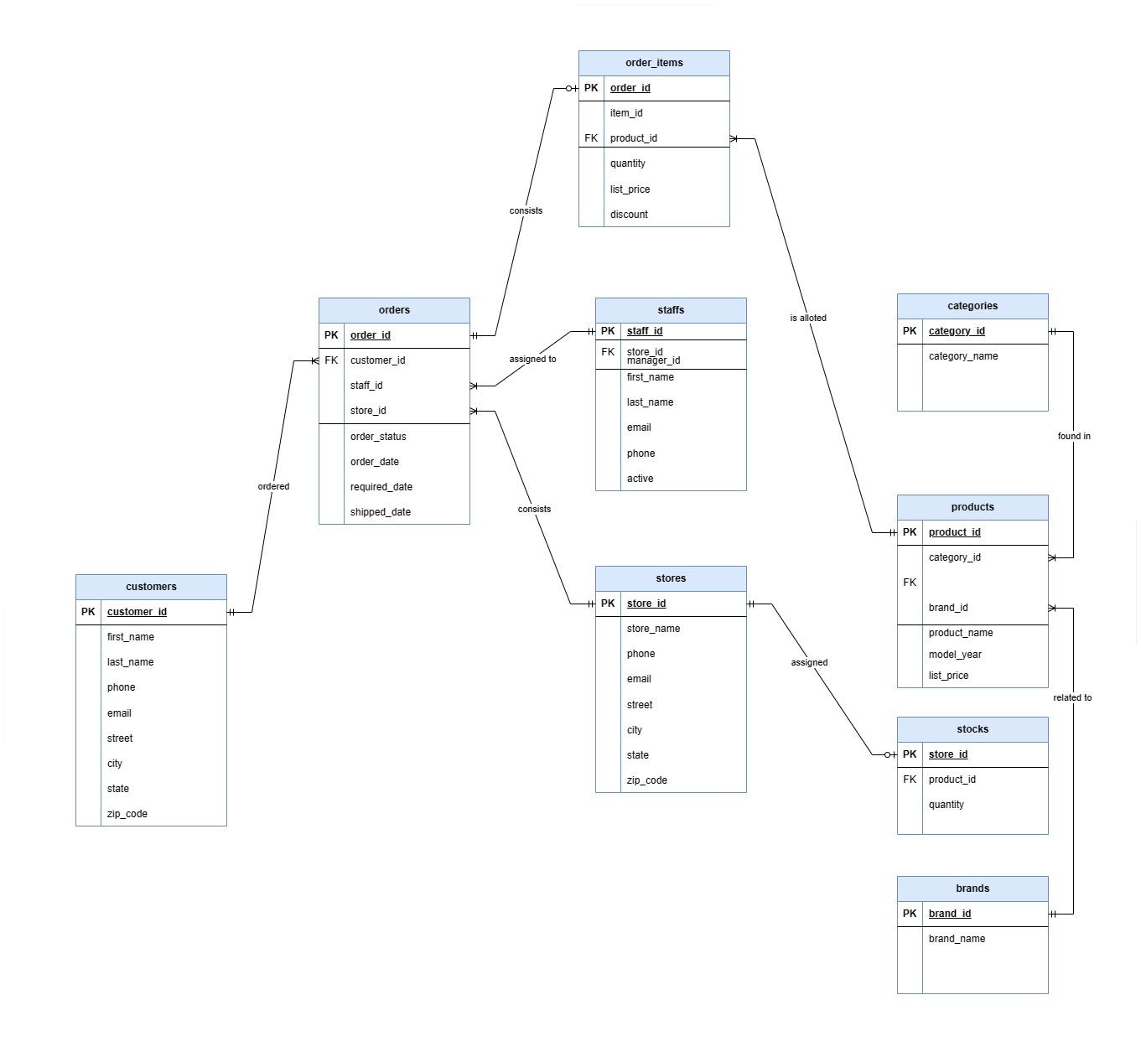
ER DIAGRAM

Slide 24
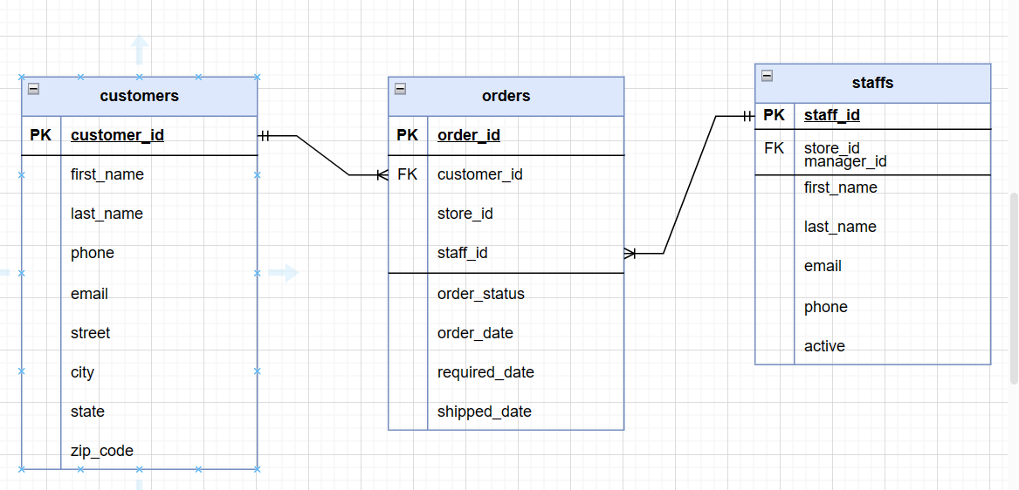
Customer and Staff have many to many relationship which is bridged by the Orders table.

Slide 25
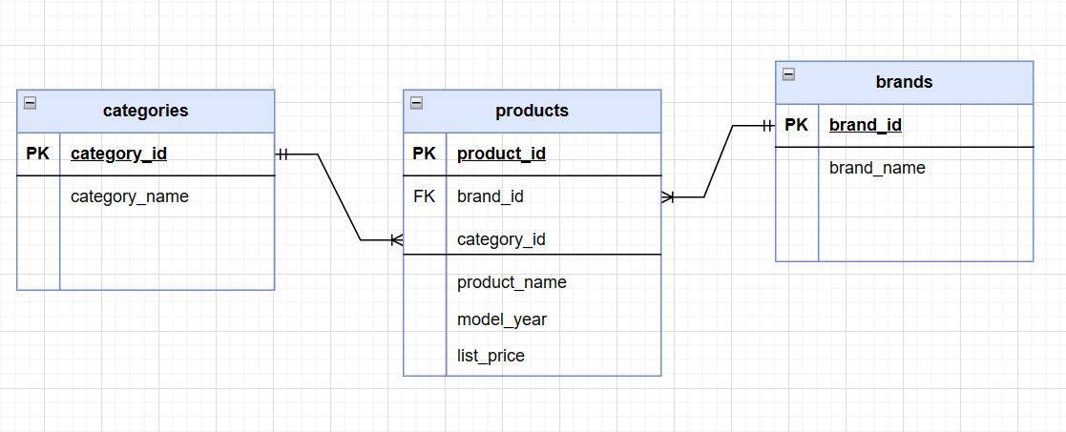
Categories and Brands have many to many relationship which is bridged by the Product table.

Slide 26
Queries

Slide 27
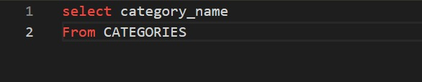
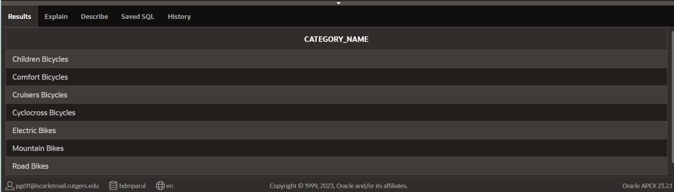
1. What are the different categories of bikes in a bike store?
Query:
Output:
Explanation:
It provides all the categories of bike from category table.

Slide 28
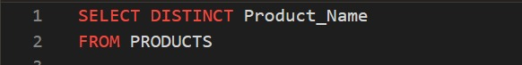
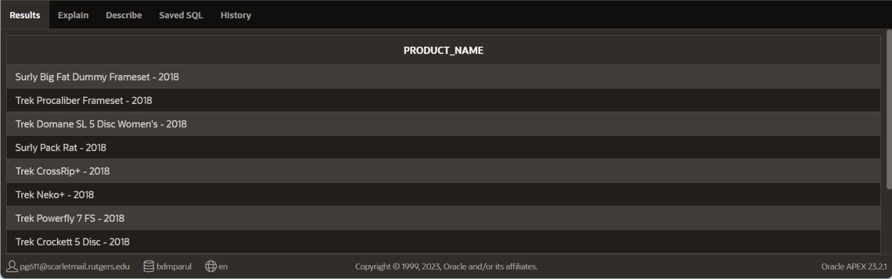
2. What are the unique product names in products table?
Query:
Output:
Explanation:
It provides Unique product names of bike from products table.

Slide 29
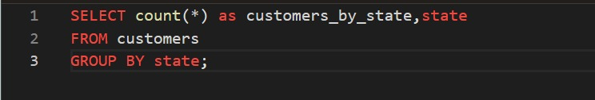
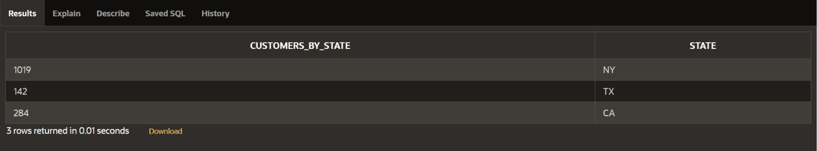
3. What are the total number of customers enrolled in each state?
Query:
Output:
Explanation:
This counts the total number of customers in each state.

Slide 30
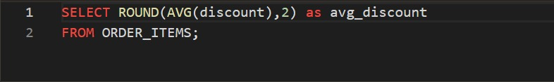
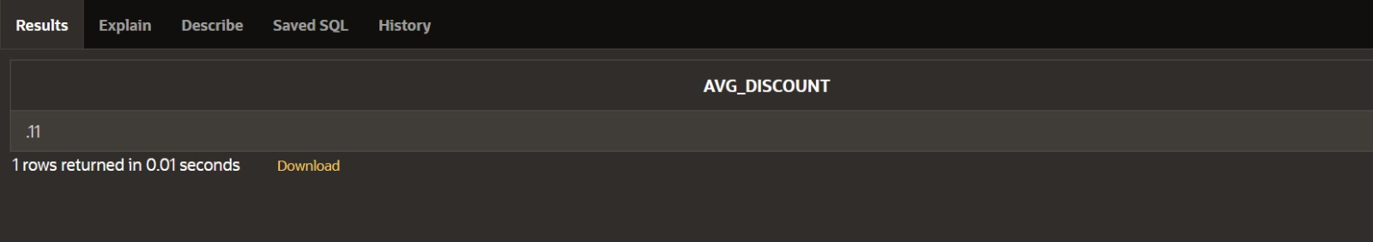
4. What is the average discount given to a customer upto 2 decimal places?
Query:
Output:
Explanation:
It is essential to get the information of what average discounts the customers are getting.
The ROUND function in SQL is used to round a numeric value to a specified number of decimal places.

Slide 31
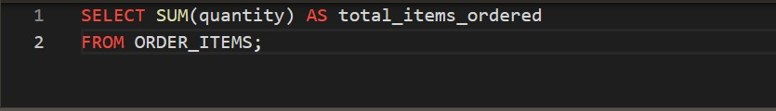
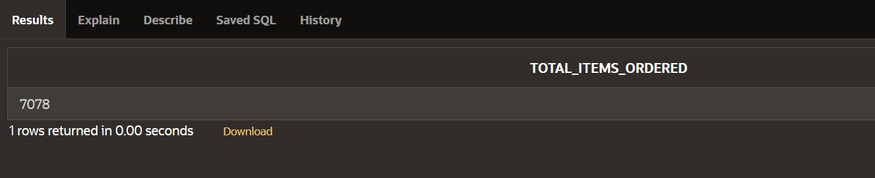
5. What are the total number of items sold?
Query:
Output:
Explanation:
Use sum function to get total items quantity that is sold.

Slide 32
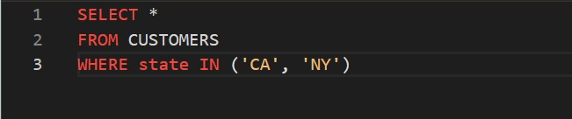
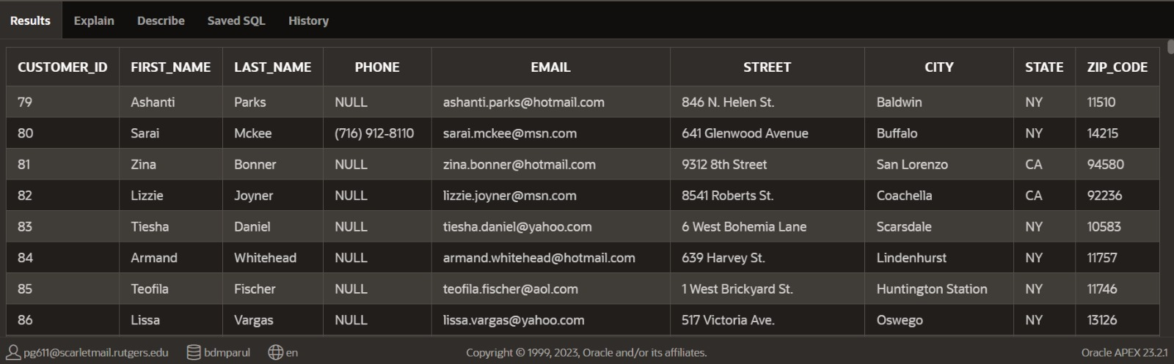
6. Retrieve all information for customers located in either California (CA) or New York (NY).
Query:
Output:
Explanation: This SQL query selects all columns from the "CUSTOMERS" table where the state is either California or New York, filtering the results based on the specified conditions.

Slide 33
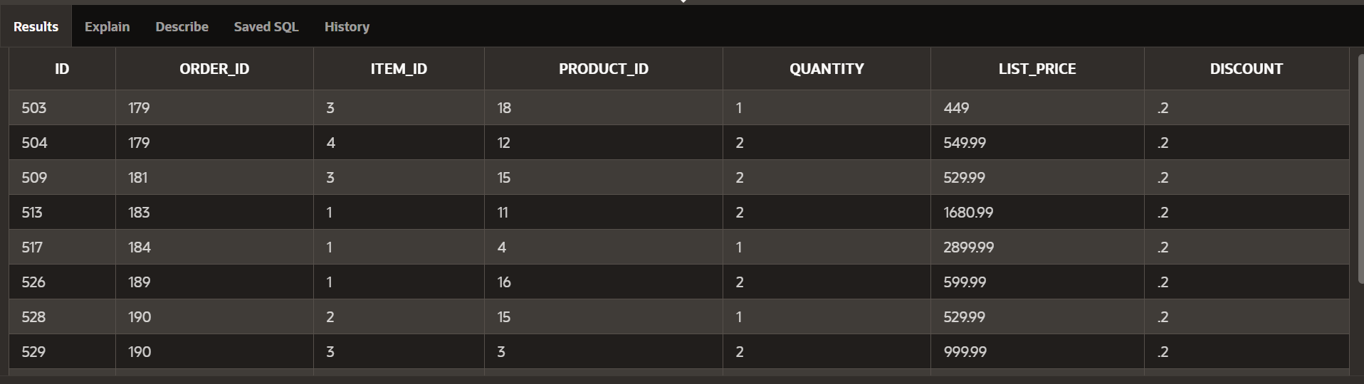
7. List the products with a Discount Greater Than 15%
Query & Output:
Explanation: This SQL query selects all columns from the "order_items" table where the discount is greater than 0.15, filtering and retrieving rows with discounts exceeding the specified threshold.

Slide 34
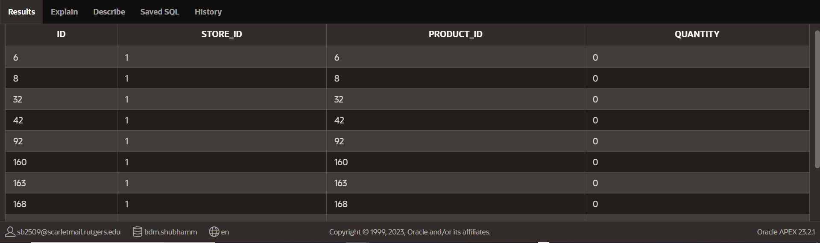
8. Provide the products with zero quantity in the store
Query:
Output:
Explanation: This SQL query selects all columns from the "stocks" table where the quantity is equal to zero, retrieving rows that represent items with no available stock.

Slide 35
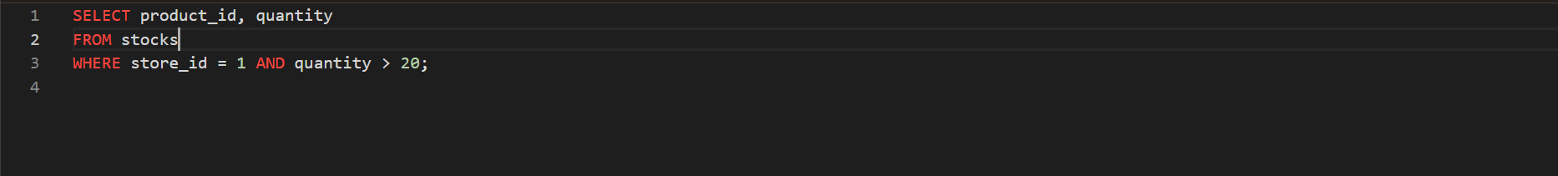
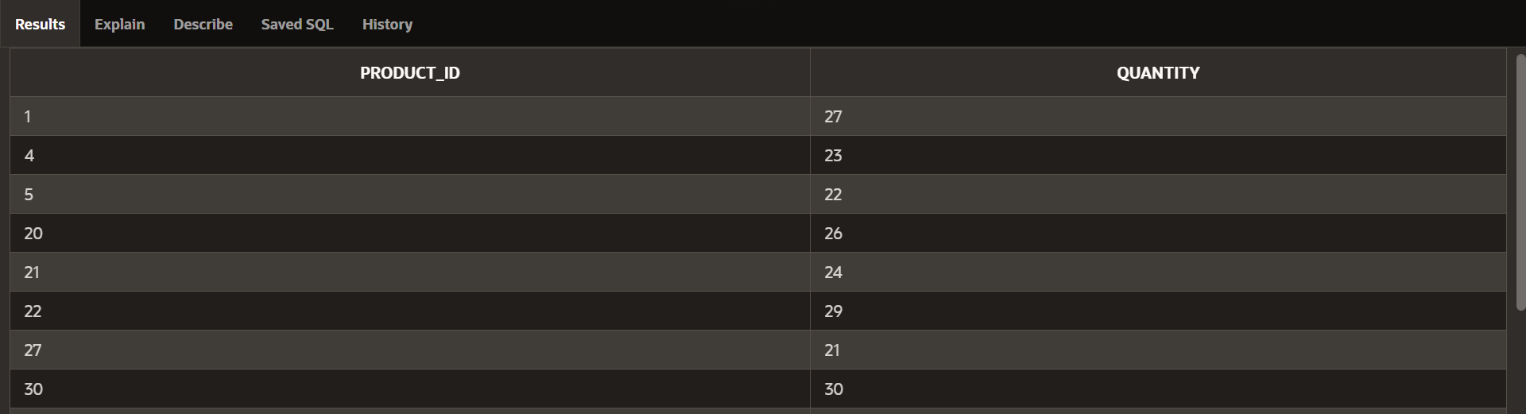
9. Provide the products Sold in Quantities Greater Than 20
Query:
Output:
Explanation: This SQL query retrieves the product_id and quantity from the 'sales' table where the store_id is 1 and the quantity is greater than 20. It filters sales data based on specified conditions.

Slide 36
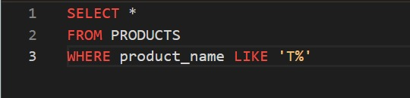
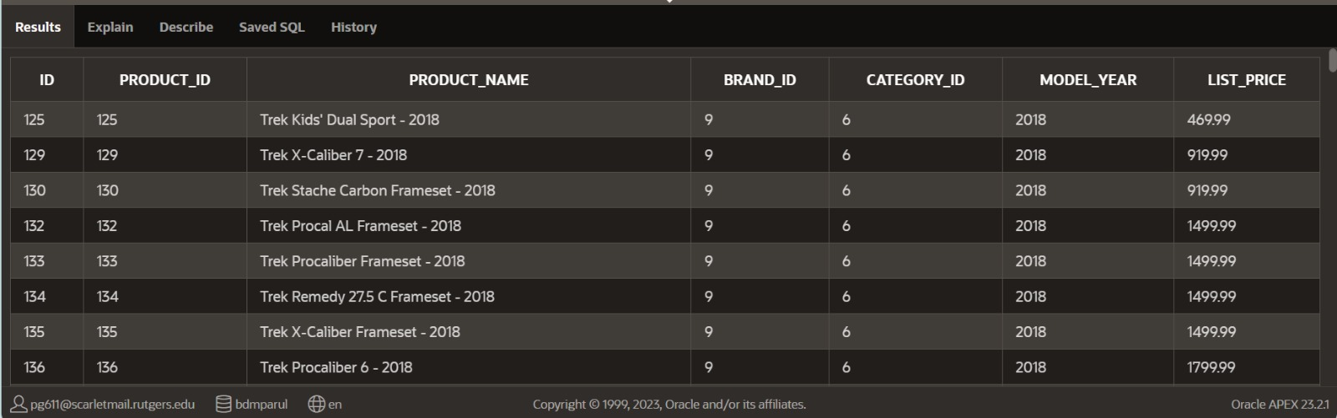
10. Retrieve all information for products whose names start with the letter 'T'.
Query:
Output:
Explanation: This SQL query selects all columns from the "PRODUCTS" table where the product name begins with the letter 'T', using the LIKE operator with a pattern match.

Slide 37
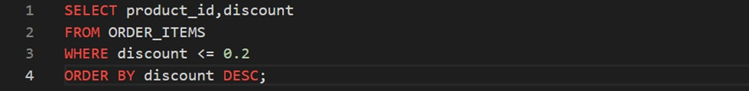
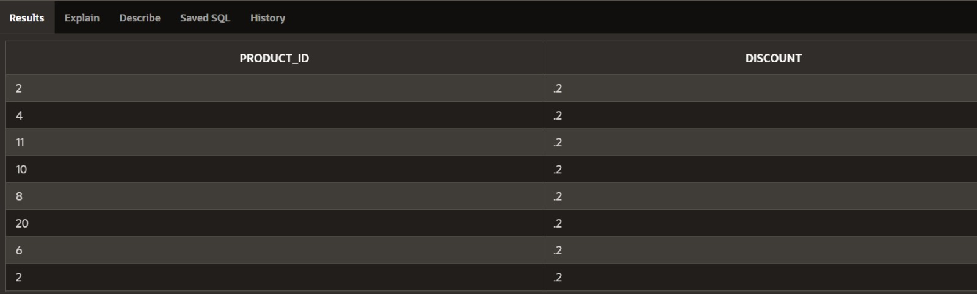
11. Provide the product id whose discount is less than 20%?
Query:
Output:
Explanation:
This is important because it will indicate what all products have the low discount to buy.

Slide 38


12. What is the average of final value of sales greater than 1000?
Query:
Output:
Explanation:
This information is important because it will indicate the value of sales more than 1000.

Slide 39

13. What is the count of customers by state?
Query & Output:
Explanation: This SQL query retrieves the count of customers for each unique state from the "customers" table, grouping the results by state. It provides a summary of the total customers in each state.

Slide 40


14. What is the Total Number of Orders Placed by Each Customer?
Query:
Output:
Explanation: This SQL query selects the customer ID and counts the total orders placed by each customer from the "orders" table. The results are grouped by customer ID, providing an order count per customer.

Slide 41


15. What is the Product count of different brands?
Query:
Output:
Explanation: This SQL query retrieves the brand ID, brand name, and the count of products for each brand, including those with no products. It uses a LEFT JOIN, GROUP BY, and orders results by product count in descending order.

Slide 42


16. Retrieve the top staff members based on the count of orders they have handled, and order the results by the count in descending order.
Query:
Output:
Explanation: This SQL query counts the number of orders handled by each staff member, groups the results by staff ID, and orders the output to display the top staff members based on the count of orders in descending order.

Slide 43


17. What is the most sold item and the total value of its sale?
Query:
Output:
Explanation: It Provides the hot product id in the market and its total value for sale.

Slide 44


18. Provide the name and the value of the best selling product?
Query:
Output:
Explanation: The query retrieves product details, including the total quantity sold (quant), list price, and product name, by joining the order_items and products tables, grouping by product ID, list price, and product name, and ordering the results by total quantity in descending order.

Slide 45


19. Retrieve the top 3 staff members based on the count of orders they have handled, including the total count, staff ID, store ID, first name, and last name, and order the results by the count in descending order?
Query:
Output:
Explanation: It uses the COUNT function to calculate the number of orders handled by each staff member, joins the orders and staffs tables based on the staff ID, groups the results by staff ID, store ID, first name, and last name, and then orders the results in descending order of the order count. The FETCH FIRST 3 ROWS ONLY clause limits the output to the top 3 staff members.

Slide 46


20. Retrieve the count of quantities for each store?
Query:
Output:
Explanation: This SQL query counts the quantities in the stocks table for each store, joins with the stores table based on the store ID, groups the results by store ID, store name, and state.

Slide 47


21. Retrieve records where the brand ID is 9 and the discount is greater than or equal to 20%?
Query:
Output:
Explanation: This query filters records from an unspecified table where the brand ID is 9 and the discount is 20% or higher.

Slide 48


22. Retrieve the customer ID along with their most recent and second most recent order dates from the "orders" table.
Query:
Output:
Explanation: This SQL query uses self-joins on the "orders" table to find the most recent and second most recent order dates for each customer, grouping the results by customer ID.

Slide 49


23. Provide the Total Number of Products in Each Category
Query:
Output:
Explanation: This SQL query retrieves the category ID, category name, and the count of products for each category, including categories with no products. It uses a LEFT JOIN and GROUP BY clause.

Slide 50

24. What is the Total Revenue Generated by Store 1?
Query & Output:
Explanation: This SQL query calculates the total revenue by multiplying the list price of products with their corresponding quantities in stock at store_id 1. It involves a JOIN between "stocks" and "products".

Slide 51


25. Retrieve distinct order IDs and customer IDs for orders that have at least one item with a discount of 20% or more in the "order_items" table.
Query:
Output:
Explanation: This SQL query selects unique order IDs and customer IDs from the "orders" table for orders where at least one item in the corresponding "order_items" table has a discount of 20% or more, utilizing the EXISTS clause for the subquery condition.

Slide 52


26. Which are the top products in each store?
Query:
Output:
Explanation: This SQL query uses a common table expression (CTE) to rank products by quantity within each store and selects the products with the highest quantity ranking (1) from the CTE.

Slide 53


27. Provide the maximum , minimum and average quantity of the Products.
Query:
Output
Explanation: This SQL query retrieves the maximum, minimum, and average quantity values for each unique product_id from the "stores" table, grouping the results by product_id.

Slide 54

28. Find out total how many members of the staff are active?
Query and Output:
Explanation: This SQL query counts the number of staff members for each "active" status, grouping results by the "active" column. It provides a count of active and inactive staff members.

Slide 55


29. Find out the total price for each order.
Query:
Output:
Explanation:This SQL query calculates the total price for each order by multiplying the quantity, list price, and discount-adjusted price of items, grouping results by order ID. It involves joining two tables.

Slide 56



30. Find out the Top 10 selling products and arrange in Descending Order.
Query:
Output:
Explanation: This SQL query retrieves the total quantity sold for each product in Store 1, groups results by product, orders them by descending total quantity sold, and limits the output to 10 rows.

Slide 57
VISUALIZATION

Slide 58

Visualization
Create a line plot showing the 30-day moving average of orders over time, with each store's trend distinguished by color, while removing axis labels and ticks for a cleaner visualization.

Slide 59

Visualize customer characteristics using subplots with count plots for purchase frequency, purchase recency, and buying power, while sharing the y-axis for easier comparison. Remove axis labels and titles for a clean presentation.

Slide 60

Generate a bar plot illustrating the average units sold per month, differentiated by product category, with axis labels removed for clarity, and displaying the error bars.

Slide 61
Thank you

